Slide 1
Insights
Organisatiion
SHIVAM SHARMA

Slide 2
Introduction
To find Data-Driven Insights for Departmental Performance and Resource Allocation.
To analyze departmental performance and recommend a resource allocation strategy based on data-driven insights..
Analysis of departmental performance.
Comparison of departmental value across quarters.
Proposal for optimizing resource allocation.
Summary of key findings and recommendations.

Slide 3
Analyzing Departmental Value
Content:
Explanation of department value: It's a metric calculated as the ratio of Actual Productivity to Department Quarterly Spend.
Formula: Department Value = Actual Productivity / (Department Quarterly Spend / 2) (normalized to 0-1)

Slide 4
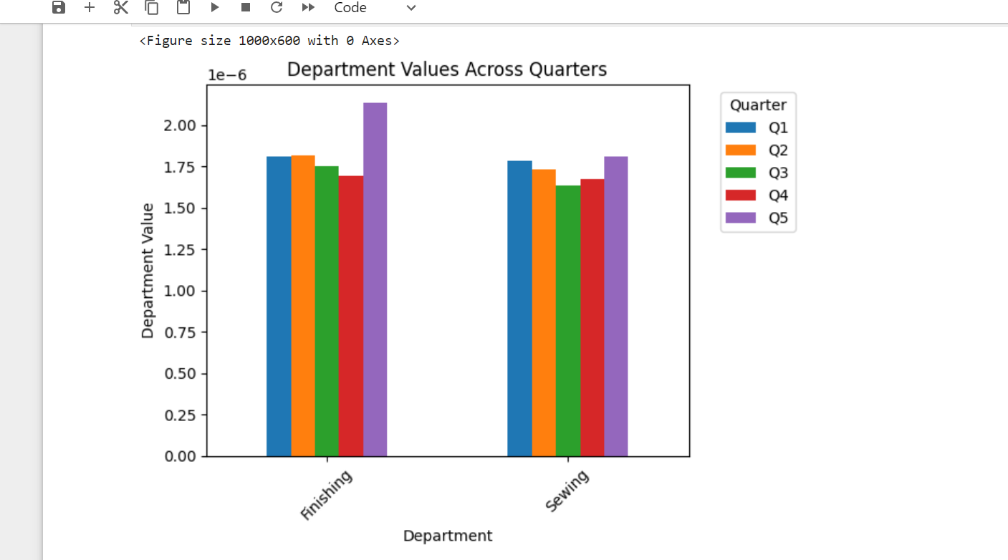
Visualization

Slide 5
Optimizing Resource Allocation
Proposal for resource allocation strategy:
Allocate resources based on departmental performance, with a focus on maximizing department value.
Consider historical performance, potential for improvement, and alignment with organizational goals.
Explanation of the rationale behind the proposed allocation strategy, including potential benefits and trade-offs.

Slide 6
Conclusion
Observation: The departmental value of the Finishing department is greater than that of the Sewing department.
Insight: Despite the Finishing department showing higher departmental value, it's crucial to note that the Sewing department requires more focus.
Recommendation: Allocate resources and efforts towards enhancing productivity and efficiency in the Sewing department to improve its departmental value and overall performance.
Impact: By prioritizing improvement initiatives in the Sewing department, we can achieve better overall organizational performance and maximize the utilization of resources.

